Slide 1
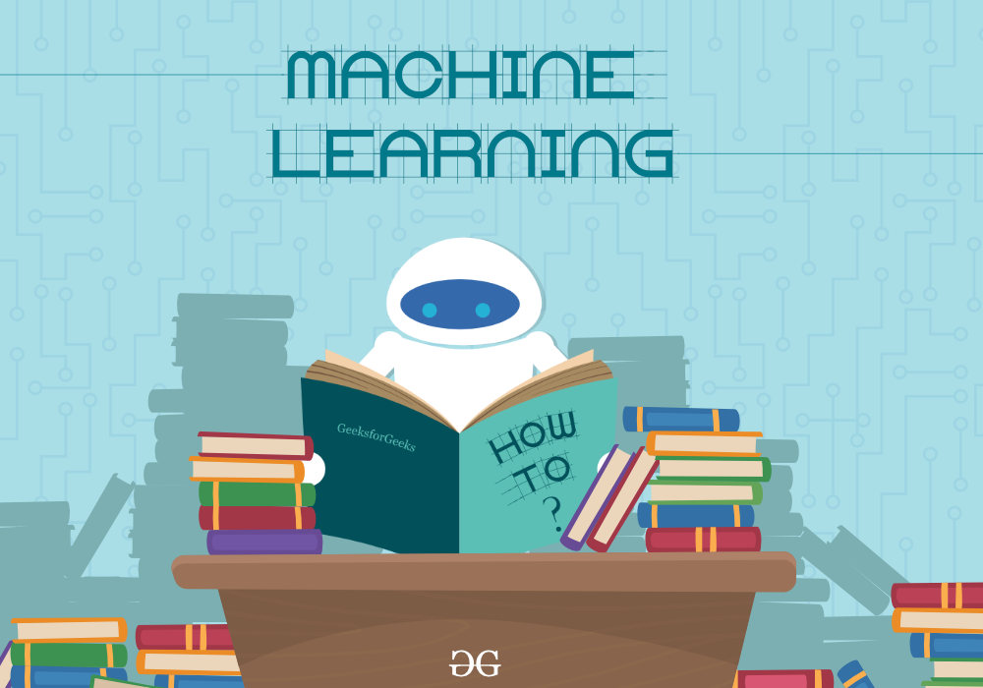
Artificial Intelligence
Learning
The act, process, or experience of gaining knowledge or skill

Slide 2
Outline
Learning
Learning Agent
Types of Learning
Rote Learning
Learning by Analogy
Learning by Example

Slide 3
What is Learning?
Psychology:
Learning is the process of acquiring new understanding, knowledge, behaviors, skills, values, attitudes, and preferences -[Richard Gross, Psychology: The Science of Mind and Behavior 6E, Hachette UK, ISBN 978-1-4441-6436-7]
Examples
Walking (motor skills)
Riding a bike (motor skills)
Telephone number (memorizing)
Playing Cards Game (strategy)
Develop scientific theory (abstraction)
Language
Recognize fraudulent credit card transactions
Etc.

Slide 4
What is Machine Learning?
Learning denotes “changes in the system that are adaptive in the sense that they enable the system to do the same task or tasks drawn from the same population more efficiently and more effectively the next time”. - Herbert A. Simon, 83
Agents can improve their performance through diligent study of their own experiences. - Russell & Norvig

Slide 5
(One more) Definition of Machine Learning
Definition [Tom Mitchell, 1997]:
A computer program is said to learn from
Experience E w.r.t. some class of
Tasks T and
Performance measure P
if its performance at tasks in T, as measured by P, improves with experience E.
Given : A task T performance measure P Some experience E with the task
Goal: Generalize the experience E in a way that allows to improve your performance P on the task T.
Spam Filtering
T: Classify emails HAM / SPAM
E: Examples (e₁,HAM),(e₂,SPAM),(e₃,HAM),(e₄,SPAM), ...
P: Prob. of error on new emails
Personalized Retrieval
T: Driving on four-lane highways using vision sensors
E: Sequence of image and steering commands recorded while observing a human driver
P: Average distance traveled before a human-judged error
Play Checkers
T: Play checkers
E: games against self
P: percentage wins
Notes:
What if the learned knowledge is never needed? e.g. a telephone number that you never call?
What if you cannot measure performance/task? e.g. learned a advertisement slogan.

Slide 6
Why Should Machines Learn?
Can machines learn?
If you program a computer, has it learned anything?
If you add data to a database, is it learning?
Learning is essential for unknown environs
Everything in the environment cannot be anticipated
Designer lacks omniscience
Learning is an alternative to explicit design
Expose the agent to reality rather than trying to tell it about reality
Lazy designer

Slide 7
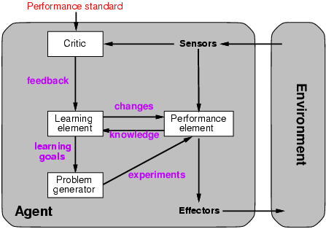
Learning Agents

Slide 8
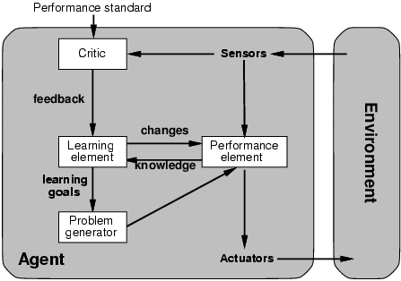
Learning agents
Quick turn is not safe
Learning enables an agent to modify its
decision mechanisms to improve performance
No quick turn
More complicated
when agent needs to learn
utility information → Reinforcement learning
(reward or penalty: e.g., high tip or no tip)
Road conditions, etc
Takes percepts
and selects actions
Try out the brakes on
different road surfaces

Slide 9
Learning Agent
Learning Element
Design of a learning element is affected by
Which components of the performance element are to be learned
What feedback is available to learn these components
What representation is used for the components
Performance Element
Mapping from conditions to actions:
Instructor says “brake”, agents learns condition-action rule for stopping
Means to infer properties of world from percepts
Agent studies pictures of buses to learn to recognize a bus
Info about how world evolves and results of possible agent actions
Brake on a wet road and observe result
Info about desirability of world states
Agent receives no tip from a passenger of a rough ride and learns value of steadiness
Problem Generator
suggests actions that might lead to new experiences
May lead to some sub-optimal decisions in the short run
In the long run, hopefully better actions may be discovered
Otherwise, no exploration would occur
Critic
informs the learning element about the performance of the action
must use a fixed standard of performance
Should be from the outside
An internal standard could be modified to improve performance
sometimes used by humans to justify low performance

Slide 10
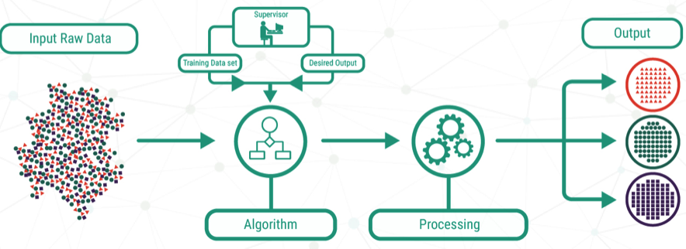
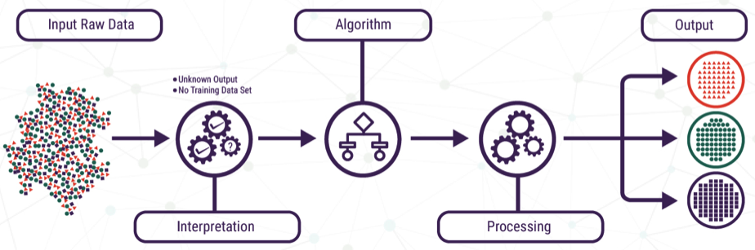
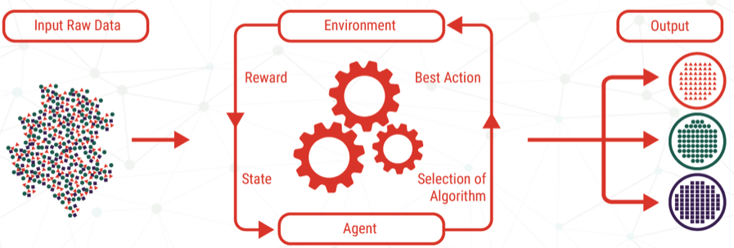
Types of Feedback
Supervised learning: (Labeled examples)
Agent is given correct answers for each example
Agent is learning a function from examples of its inputs and outputs
Unsupervised learning: (Unlabeled examples)
Agent must infer correct answers
Completely unsupervised learning is impractical, since agent has no context
Reinforcement learning: (Rewards)
Agent is given occasional rewards for correct
Typically involves subproblem of learning “how the world works”

Slide 11
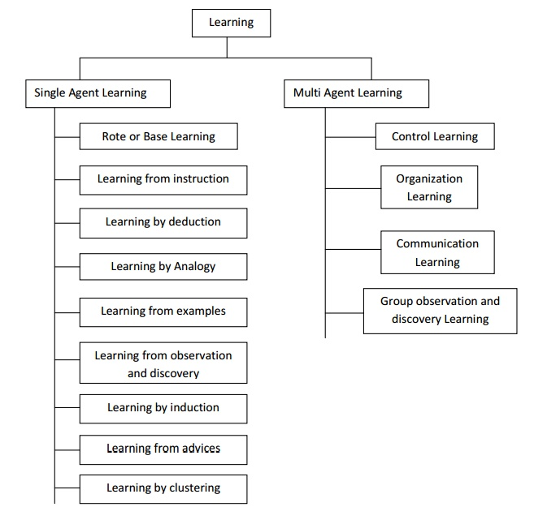
Methods of Learning

Slide 12
Rote Learning (Memorization):
Simple storage of computed information (facts/results)
No inference
Direct instruction (by being told)
Teach a robot how to hold a cup
Required inference
Analogy
Transform existing knowledge to new situation
Learn how to hold a cup then learn to how to hold object with handle
Induction
Learning from examples
Studied in machine learning
Deduction
Deductive inference steps using known facts

Slide 13
Rote learning
Rote learning consists of memorizing the solutions of the solved problems so that the system needs not to solve them again:
During subsequent computations of f(X₁, ... X_{n}), the performance element can simply retrieve (Y₁, ... , Y_{p}) from memory rather than recomputing it.

Slide 14
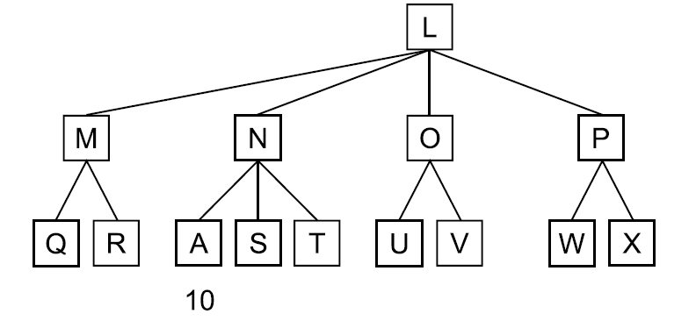
Rote learning
Memory organizations
Rote learning requires useful organization of the memory so that the retrieval of the desired information will be very fast.
Stability of the environment
The information stored at one time should still be valid later.
Store-versus-compute trade-off
The cost of storing and retrieving the memorized information should be smaller than the cost of recomputing it.

Slide 15
Direct Instruction
Direct instruction is a complex form of learning.
This type of learning requires more inference than rote learning
Since the knowledge must be transformed into an operational form before learning when a teacher presents several facts directly to us in a well-organized manner

Slide 16
Learning By Analogy
Learning by analogy means acquiring new knowledge about an input entity by transferring it from a known similar entity.
Example:
Last month, the stock market was a roller coaster.
Central intuition supporting learning by analogy:
If two entities are similar in some respects, then they could be similar in other respects as well.
Examples of analogies:
Pressure Drop is like Voltage Drop
A variable in a programming language is like a box.

Slide 17
Methods of Analogical Problem Solving
Analogy
Transformational

Slide 18
Methods of Analogical Problem Solving
Analogy
Transformational
Derivational
void bubbleSort(int arr[], int n)
{
int i, j;
for (i = 0; i < n-1; i++)
// Last i elements are already in place
for (j = 0; j < n-i-1; j++)
if (arr[j] > arr[j+1])
swap(&arr[j], &arr[j+1]);
}
def bubbleSort(arr):
n = len(arr)
for i in range(n):
# Last i elements are already in place
for j in range(0, n-i-1):
if arr[j] > arr[j+1] :
arr[j], arr[j+1] = arr[j+1], arr[j]

Slide 19
Learning by Examples: Inductive
Basic Problem: Induce a representation of a function (a systematic relationship between inputs and outputs) from examples.
target function f: X → Y
example (x,f(x))
hypothesis h: X → Y such that h(x) = f(x)
x = set of attribute values (attribute-value representation)
x = set of logical sentences (first-order representation)
Y = set of discrete labels (classification)
Y = Continuous values (regression)

Slide 20
Learning by Examples: Inductive
Simplest form: learn a function from examples
f is the target function
An example is a pair (x, f(x))
Pure induction task:
Given a collection of examples of f, return a function h that approximates f.
Problem: find a hypothesis h, such that h ≈ f, given a training set of examples
This is a highly simplified model of real learning:
Ignores prior knowledge
Assumes examples are given
Learning a discrete function is called classification learning.
Learning a continuous function is called regression learning.

Slide 21
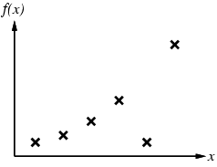
Inductive learning method
Fitting a function of a single variable to some data points
Examples are (x, f(x) pairs;
Hypothesis space H – set of hypotheses we will consider for function f, in this case polynomials of degree at most k
Construct/adjust h to agree with f on training set
h is consistent if it agrees with f on all examples
E.g., curve fitting:

Slide 22
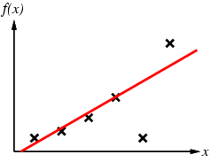
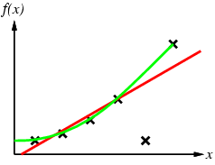
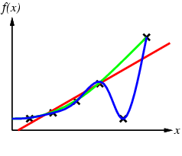
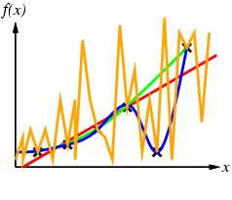
Multiple consistent hypotheses?
Polynomials of degree at most k
Linear hypothesis
Degree 1 polynomial
hypothesis
Degree 3 polynomial
and approximate linear fit
How to choose from among
multiple consistent hypotheses?
Ockham's razor:
Prefer the simplest hypothesis consistent with data
Maximize a combination of consistency and simplicity
Sinusoidal hypothesis

Slide 23
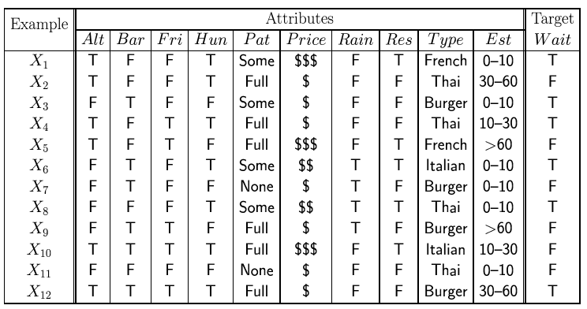
Learning Decision Trees (LDT)
Decision tree branch on values of a set of input attributes, leading to answers at the leaves.
Construction (and optimization) of the tree is a learning problem.
Classification learning: learning a discrete function
Regression: learning a continuous function
Problem: Wait for a table at a restaurant?
Attributes:
Alternate: is there an alternative restaurant nearby?
Bar: is there a comfortable bar area to wait in?
Fri/Sat: is today Friday or Saturday?
Hungry: are we hungry?
Patrons: number of people in the restaurant (None, Some, Full)
Price: price range ($, $$, $$$)
Raining: is it raining outside?
Reservation: have we made a reservation?
Type: kind of restaurant (French, Italian, Thai, Burger)
WaitEstimate: estimated waiting time (0-10, 10-30, 30-60, >60)

Slide 24
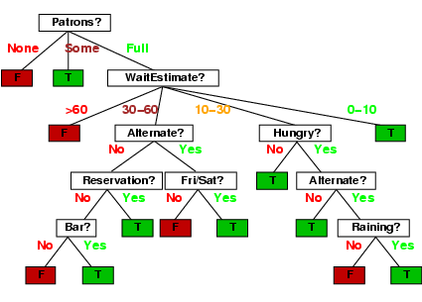
DT Example

Slide 25
Illustrating Classification Task

